Slide 1
VIP/Senior Project Final Presentation Fall 2017
AR-VR-VE for Computer Science Education 1.0
Team Member(s):
Bernardo Blum, Santiago Bolivar, Lukas Borges, Cristian Cabrera, Nicolette Celli, Hamilton Chevez, Kevin Delamo, Filip Klepsa, Francisco Lozada
Product Owner(s):
Francisco Ortega
Instructor:
Francisco Ortega & Masoud Sadjadi
School of Computing and Information Sciences Florida International University
Notes:
Greet your audience, thank them for attending your presentation, introduce yourself, introduce your project, introduce your team members, and quickly indicate what each of you did in a high-level manner, and put more emphasis on your part/contribution.

Slide 2
Problem definition
The objective of the project is to present to increase the enrollment of students in Computer Science courses through the use of augmented and virtual reality technologies.
CodeAdventures teaches Computer Science concepts implicitly by having the player create a state machine to control a robot to reach a goal.
The previous system was too complicated for many users to understand, so we aimed to implement features to make the game more clear.
Notes:
Introduce the problem that the whole project tackles and stay focused on the parts that you have been working. Indicate if there is an existing previous system, enumerate its problems/limitations, etc.

Slide 3
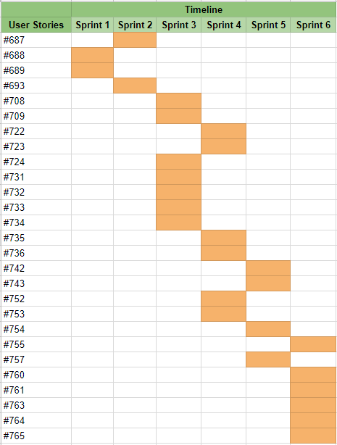
Project Management

Slide 4
Requirements: User Stories
#688 Learn Unity
#689 Learn Blender
#687 Add Keyboard/Mouse Controls
#693 Add an Indicator
#724 Change the Key’s Material
#709 Option to Change Input Device
#708 Options Menu to Change Game Settings
#731 Have Robot Communicate
#732 Create Button for Completing Level
#733 Prevent Robot from Going Through Walls
#734 Create Lightning Door
#722 Add a Main Menu
#723 Add Instructions for Controls
#735 Create Second Level Model
#736 Create Impassable Areas
#752 Add an In-game Menu
#753 Fix Ambient Lighting
#742 Create Module Transitions
#743 Add Left Turn Module
#754 Add Right Turn Module
Notes:
4. Requirements:
4.1. User stories implemented (one or more slides).
4.2. UML use cases and the use case diagram for the implemented use cases (one or more slides).
4.3. UML sequence diagrams for the implemented use cases.

Slide 5
Requirements: User Stories
#757 Proceed to Next Level
#755 Create Third Level
#760 Highlight Modules During Transitions
#761 Destroy Transitions
#763 Add Congratulations Message
#764 Create Tutorial
#765 Adapt Main Menu to VR
Notes:
4. Requirements:
4.1. User stories implemented (one or more slides).
4.2. UML use cases and the use case diagram for the implemented use cases (one or more slides).
4.3. UML sequence diagrams for the implemented use cases.

Slide 6
Requirements: User Stories
Our main goal was to improve clarity and make the game more easier to understand. These user stories were essential:
#693 Add an Indicator
#723 Add Instructions for Controls
#760 Highlight Modules During Transitions
#764 Create Tutorial
Notes:
4. Requirements:
4.1. User stories implemented (one or more slides).
4.2. UML use cases and the use case diagram for the implemented use cases (one or more slides).
4.3. UML sequence diagrams for the implemented use cases.

Slide 7

Requirements: Use Cases
Most of our implemented use cases involved direct interaction with the system. Below is an example for picking up and moving a box object:
Notes:
4. Requirements:
4.1. User stories implemented (one or more slides).
4.2. UML use cases and the use case diagram for the implemented use cases (one or more slides).
4.3. UML sequence diagrams for the implemented use cases.

Slide 8
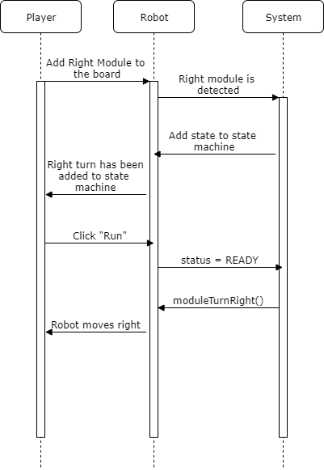
Requirements: Sequence Diagrams
Right Turn Module Sequence Diagram
Notes:
4. Requirements:
4.1. User stories implemented (one or more slides).
4.2. UML use cases and the use case diagram for the implemented use cases (one or more slides).
4.3. UML sequence diagrams for the implemented use cases.

Slide 9
System Design: Architecture
CodeAdventures follows a Model-View Controller architecture.
The Unity scene functions as a View, the game objects as Models, and the C# scripts as controllers.
This structure is standard for Unity projects and will allow us to separate the application’s data, logic, and user interface, making it easier for future collaborators to continue our project.
Notes:
5. System design:
5.1. System decomposition; identify the architecture patterns used (one slide).
5.2. System deployment – h/w and s/w requirements (one slide).
5.3. Persistent data design (one slide).
5.4. Security/Privacy (one slide).

Slide 10
System Design: Deployment
Software Resources
Unity 5.6.1
SteamVR plugin for Unity
Visual Studio Community 2017
Blender 2.79
Hardware Resources
HTC Vive
Dell Alienware Laptop
Intel Core i7-6700HQ quad-core processor
16GB RAM
NVIDIA GeForce GTX 970M graphics card
Notes:
5. System design:
5.1. System decomposition; identify the architecture patterns used (one slide).
5.2. System deployment – h/w and s/w requirements (one slide).
5.3. Persistent data design (one slide).
5.4. Security/Privacy (one slide).

Slide 11
System Design
Models
States: Represents a state from a state machine with two properties: Id that uniquely identifies the state, and Type which represents the function given to the robot to issue an action.
Transitions: Represents a transition from a state machine with three properties: Id that uniquely identifies the transition, From which is the state it is transitioning from, and To which is the state it is transitioning to.
Modules: Represents the GameObject that holds the properties of the state model.
Robot: The main programmable robot that the player interacts with.
Board: Model where the state machine is built by placing and attaching modules together.
Tether: Represents a transition between two states.
Controllers
Robot Controller: Controls the robot; has knowledge of the created state machine.
State Machine Controller: Builds the state machine based on the given modules.
Board Controller: Recognizes any module placed or removed from the board. Converts module data to states and sends it to the robot controller.
Vive Controller: Adds functionality for the Vive controller. Allows for toggling of the board, running the state machine, restarting or quitting the level, and player interaction with GameObjects.
Views
Unity Scene: The scene which the player is loaded into and each model gets instantiated in. Currently loads three levels.
Notes:
5. System design:
5.1. System decomposition; identify the architecture patterns used (one slide).
5.2. System deployment – h/w and s/w requirements (one slide).
5.3. Persistent data design (one slide).
5.4. Security/Privacy (one slide).

Slide 12
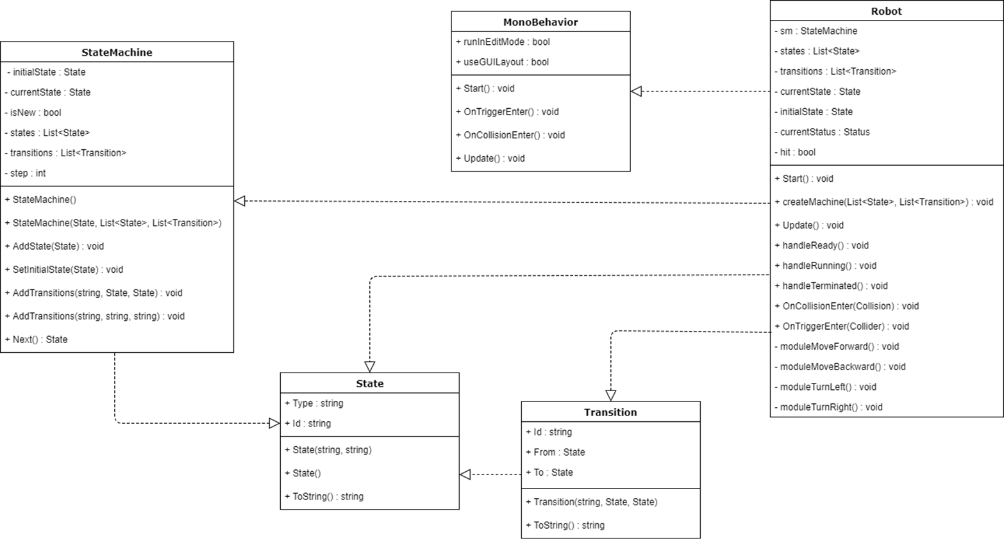
Minimal Class Diagram
Notes:
6. Detailed design:
6.1. Minimal class diagram. Identify the design patterns used (one or more slides).
6.2. State machine for the main control object or the most important object of the implemented uses cases (one or more slides).
6.3. Main algorithm used related to an implemented use case described above (one or more slides).

Slide 13
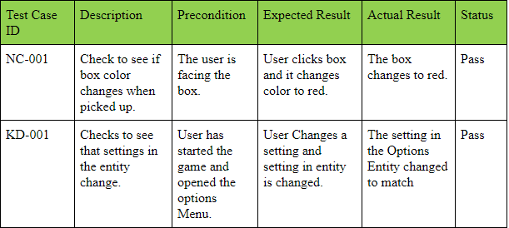
Test Suites and Test Cases
Notes:
7. Test Suites and Test Cases (one sunny day and one rainy day) for the use case represented in part (5) above (2 slides).
7.1 One sunny day and one rainy day for the implemented use cases (one or more slides).
7.2 Automated test scripts for the implemented use cases (one or more slides).

Slide 14
Summary
Using video games is an accessible and exciting way to introduce Computer Science concepts. New students will be drawn to the field, and it instills a sense of confidence and proves that programming is achievable. Future projects will create more complex logic puzzles.
Contact:
ncell002@fiu.edu
kdela033@fiu.edu
Questions?
Thank You!
Notes:
Summarize your contribution
Include your contact information
Ask if anyone has any questions for you.
Thank your audience

